Slide 1
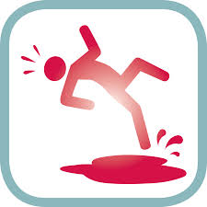
Circumstances of injuries
Dr Nirmala Perera
2016

Slide 2
Circumstances are determined by
History
Eye witnesses account
Circumstantial evidence
Medical evidence

Slide 3
Circumstances of injuries
Accidental (rare)
Homicidal/intentional
Suicidal/Self inflicted

Slide 4
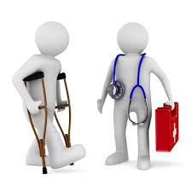
Medical evidence
Type of wounds
Position of the injury
Number of wounds
Presence or absence of weapon
Presence of defense injury
Presence of self inflicted scars

Slide 5
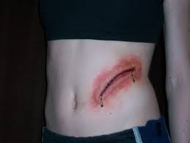
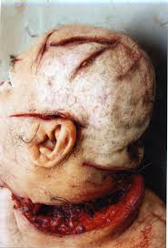
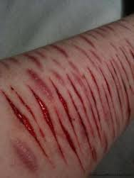
Position of injury
Lacerations | Cut injury
Margins irregular | Margins are sharply cut
Tissue bridging present | No tissue bridging
Floor is uneven | Floor is even
Less bleeding | Bleed profusely
Hair bulbs crushed | Hair bulbs are cut
Suicide | Homicide
Over an accessible area | Over inaccessible area
Over an elective site | Any where in the body
Tentative cuts may present | Tentative cuts are absent

Slide 6
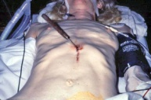
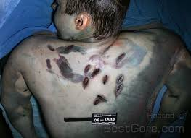
Number of wounds
Suicide
Homicide
Single fatal injury
Multiple fatal injuries

Slide 7
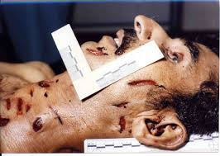
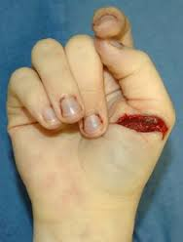
Nature of wounds
Suicide
Homicide
Single type of injury
Multiple types of injuries

Slide 8
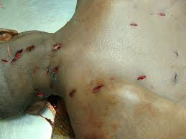
Presence of the weapon
Suicide
Homicide
Weapon found within the vicinity
Weapon is absent

Slide 9
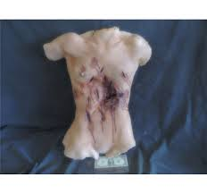
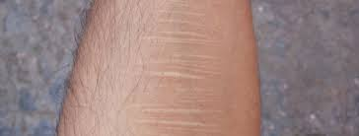
Other factors
Suicide
Homicide
Presence of self inflicted scars
Avoid clothing
Room is closed within
Defense injuries
Injuries through clothing

Slide 10
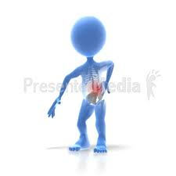
Injury patterns

Slide 11
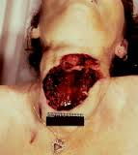
Suicidal cut throat injuries
Single cut
Starting point depend on handedness
First shallow then deepens and tails off
Mostly upper part of the neck

Slide 12
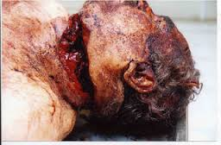
Homicidal cut throat injuries
Single or multiple cut injuries
lie both higher and lower across neck
no tentative cuts, all are forceful and deepen rapidly
slope backwards and downwards
associated with defense injuries to hands and arms

Slide 13
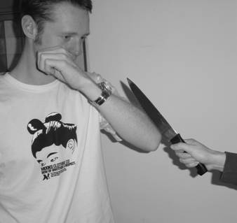
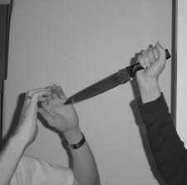
Defense injuries
Raising hands to protect chest/ head/ neck
Person is aware on attack

Slide 14
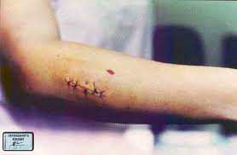
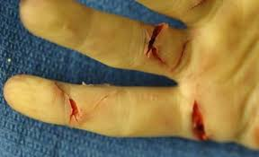
Defense injuries
wounds on dorsum of hand, back of forearms and upper arms or
Grabbing weapon with hand

Slide 15
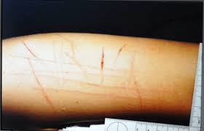
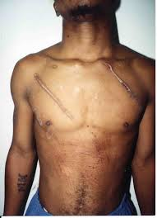
Fabricated injuries
Produced by a person on his own body (self inflicted)
Caused by another
person with his
consent

Slide 16
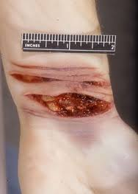
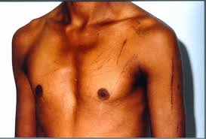
Self inflicted injuries
Multiple superficial cut injuries
Parallel to each other
Non sensitive accessible area

Slide 17
Summery
Homicidal injuries
Suicidal injuries
Self inflicted injuries

Slide 18
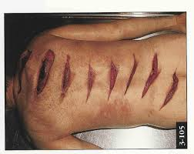
Thank you

